Slide 1
SUE
Finding
Buried
Treasure

Slide 2
SUE-Subsurface Utility Engineering
Level D
Level C
Level B
Level A

Slide 3
Statewide Survey Contract
Patrick Perry
502-782-4925
patrick.perry@ky.gov
QK4
Palmer
GRW

Slide 4
SUE Request
Project Number
County
What Level needed and Where(Provide Plan Sheet)
Word or Excel Sheet
Coordinate Control Sheet
Deliverables
Reasonable date for completion (typically month)
DGN in current KYTC CADD Standard

Slide 5
SUE Request
Quality Level A 5-159.00 |  |  |  |  |  |  | Quality Level B 5-159.00
 | Station | Offset | RT / LT | Facility Type | Surface Type |  |  | Start Station | End Station | Offset | Facility
1 | 588+08 | 102 | Lt | 24" Gas Main | Earth/grass |  | 1 | 575+00 +/- | 601+00 +/- | edge of WB lane to R/W (~158.74ft LT) | AT&T buried cable
2 | 590+96 | 106 | Lt | 12" DIW Water Main - possibly in 24" Casing pipe | Earth/grass
3 | 600+52 | 110 | Lt | 12" DIW Water Main - possibly in 24" Casing pipe | Earth/grass
4 | 604+81 | 110 | Lt | 36" Sanitary Sewer | Earth/grass
5 | 606+46 | 110 | Lt | 36" Sanitary Sewer | Earth/grass
6 | 629+91 | 97 | Lt | 24" Sanitary Sewer | Earth
7 | 648+00 | 85 | LT | UG electric in 3 1/2" conduit | Earth
8 | 139+20 | 25 | Rt | 8" DI Water Main - possibly in 12" Casing | Earth/Rip Rap
9 | 139+64 | 19 | Rt | 8" Gas Main | Earth/Rip Rap
10 | TBD | 109 | Lt | AT&T UG cable | Earth/grass
11 | TBD | 93 | Lt | AT&T UG cable | Earth

Slide 6
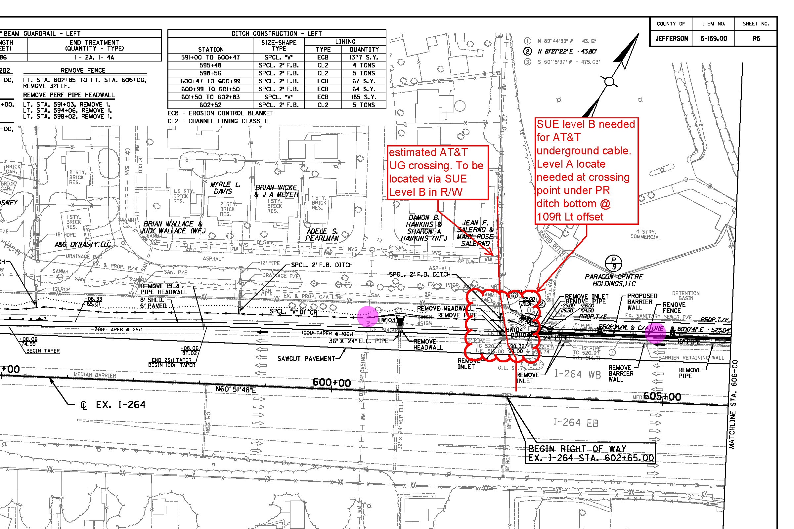

Slide 7
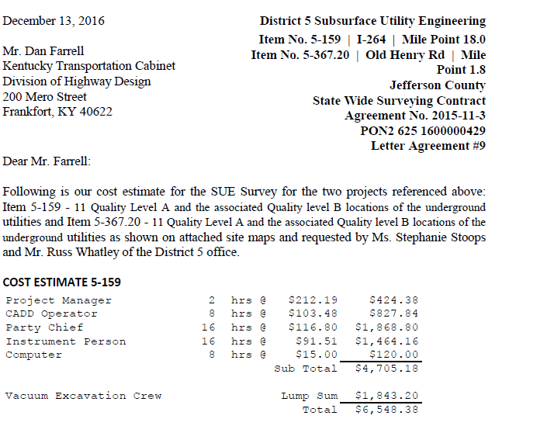
SUE Request

Slide 8
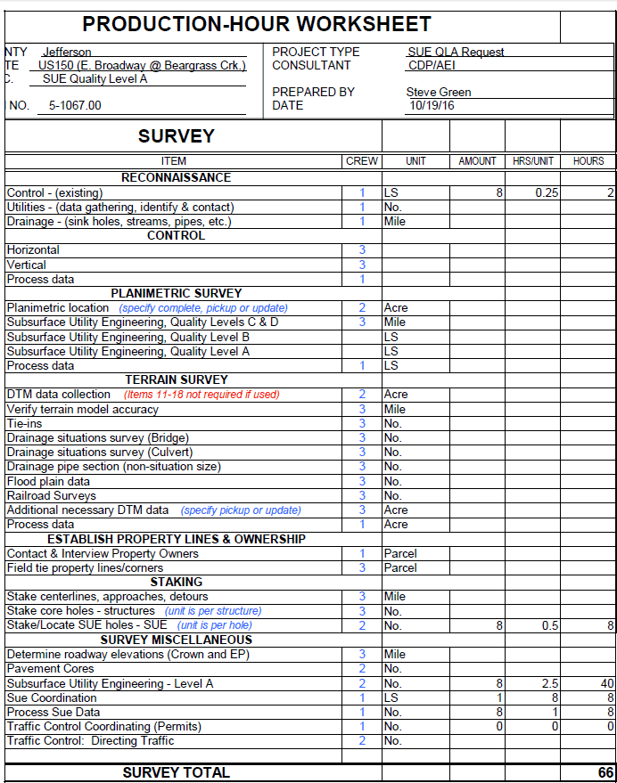

Slide 9
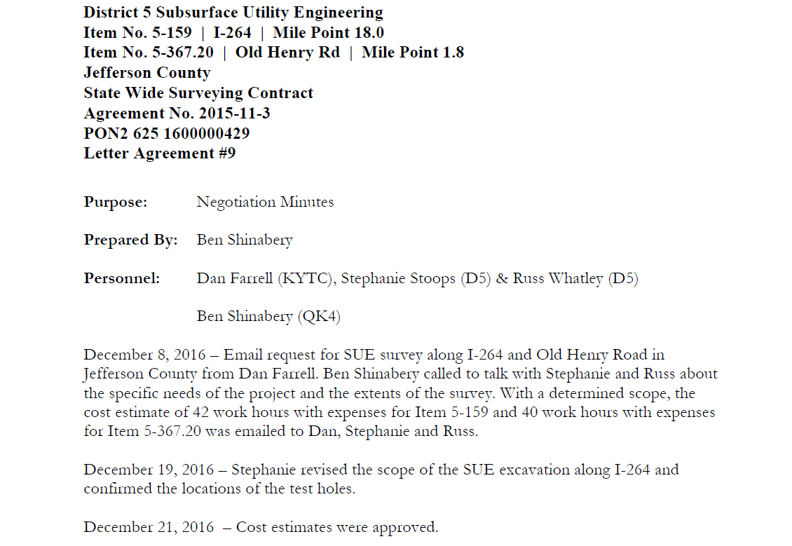

Slide 10
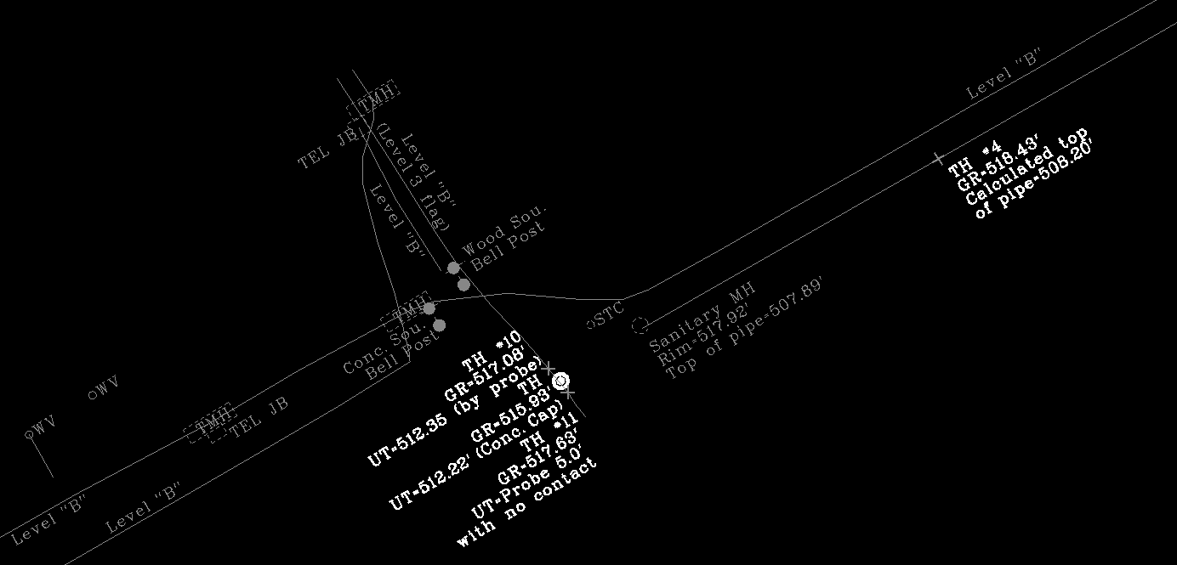
SUE Deliverables
Point | Utility & Size | Station | Offset | Project Northing | Project Easting | Ground Elevation | Depth | Top of Util. Elev. | Surface | Comment
LWC
1087 | Level "B" | 590+72.31 | 74.64' LT | 266915.98 | 1239806.68 | 515.46 |  |  | Grass | Level "B"
1088 | 12" Steel | 590+73.13 | 104.47' LT | 266942.44 | 1239792.88 | 513.86 | -4.50 | 509.36 | Grass | TH #2
1084 | Level "B" | 590+73.56 | 134.22' LT | 266968.63 | 1239778.77 | 514.00 |  |  | Grass | Level "B"
 | See comment | 600+52 | 110' LT |  |  |  |  |  |  | TH #3: No signal, could not locate
 | See comment | 139+20 | 25' RT |  |  |  |  |  |  | TH #8: No signal, could not locate
MSD
1010 |  | 603+27.72 | 105.77' LT | 267554.43 | 1240888.08 | 517.92 |  | 507.89 | Grass | Sanitary MH
1014 | 36" Sanitary | 604+88.01 | 106.14' LT | 267632.79 | 1241027.91 | 518.43 | -10.23 | 508.20 | Grass | TH #4: Calculated from MH pipe
1013 | 36" Sanitary | 606+48.81 | 107.88' LT | 267712.60 | 1241167.51 | 518.41 | -9.89 | 508.52 | Grass | TH #5: Calculated from MH pipe
1012 |  | 607+98.76 | 111.05' LT | 267788.38 | 1241296.95 | 519.32 |  | 508.81 | Grass | Sanitary MH
1078 |  | 627+23.28 | 331.31' LT | 269010.09 | 1242782.26 | 515.99 |  | 504.59 | Grass | Sanitary MH
1080 | 24" Sanitary | 629+90.55 | 97.06' LT | 268964.62 | 1243134.73 | 516.11 | -9.75 | 506.36 | Grass | TH #6: Calculated from MH pipe
1079 |  | 632+56.50 | 136.17' RT | 268919.27 | 1243485.55 | 518.45 |  | 508.13 | Grass | Sanitary MH
Electric
1097 | Level "B" | 647+75.37 | 95.33' LT | 269958.22 | 1244617.42 | 524.33 |  |  | Grass | Level "B"
1098 | 2" Iron | 647+93.96 | 95.01' LT | 269968.32 | 1244633.02 | 524.48 | -1.41 | 523.07 | Grass | TH #7: between hwy lamps
1099 | Level "B" | 648+22.36 | 94.84' LT | 269983.83 | 1244656.39 | 524.43 |  |  | Grass | Level "B"
AT&T
1232 | Level "B" | 602+76.56 | 128.2' LT | 267549.11 | 1240832.48 | 519.76 |  |  | Grass | Level "B"
1230 | Concrete Cap | 602+80.26 | 109.06' LT | 267534.19 | 1240845.02 | 517.08 | -4.73 | 512.35 | Grass | TH #10: Probe to resistance
1229 | Concrete Cap | 602+82.53 | 101.27' LT | 267528.49 | 1240850.80 | 515.93 | -3.71 | 512.22 | Grass | TH @ Flow Line
1227 | See comment | 602+82.81 | 94.95' LT | 267523.10 | 1240854.12 | 517.63 |  |  | Grass | TH #11: Sensor reading 6.5' to utility
1225 | Level "B" | 602+84.49 | 80.93' LT | 267511.68 | 1240862.41 | 520.13 |  |  | Grass | Level "B"

Slide 11
SUE Deliverables
Point | Utility & Size | Station | Offset | Project Northing | Project Easting | Ground Elevation | Depth | Top of Util. Elev. | Surface | Comment
LWC
1087 | Level "B" | 590+72.31 | 74.64' LT | 266915.98 | 1239806.68 | 515.46 |  |  | Grass | Level "B"
1088 | 12" Steel | 590+73.13 | 104.47' LT | 266942.44 | 1239792.88 | 513.86 | -4.50 | 509.36 | Grass | TH #2
1084 | Level "B" | 590+73.56 | 134.22' LT | 266968.63 | 1239778.77 | 514.00 |  |  | Grass | Level "B"
 | See comment | 600+52 | 110' LT |  |  |  |  |  |  | TH #3: No signal, could not locate
 | See comment | 139+20 | 25' RT |  |  |  |  |  |  | TH #8: No signal, could not locate
MSD
1010 |  | 603+27.72 | 105.77' LT | 267554.43 | 1240888.08 | 517.92 |  | 507.89 | Grass | Sanitary MH
1014 | 36" Sanitary | 604+88.01 | 106.14' LT | 267632.79 | 1241027.91 | 518.43 | -10.23 | 508.20 | Grass | TH #4: Calculated from MH pipe
1013 | 36" Sanitary | 606+48.81 | 107.88' LT | 267712.60 | 1241167.51 | 518.41 | -9.89 | 508.52 | Grass | TH #5: Calculated from MH pipe
1012 |  | 607+98.76 | 111.05' LT | 267788.38 | 1241296.95 | 519.32 |  | 508.81 | Grass | Sanitary MH
1078 |  | 627+23.28 | 331.31' LT | 269010.09 | 1242782.26 | 515.99 |  | 504.59 | Grass | Sanitary MH
1080 | 24" Sanitary | 629+90.55 | 97.06' LT | 268964.62 | 1243134.73 | 516.11 | -9.75 | 506.36 | Grass | TH #6: Calculated from MH pipe
1079 |  | 632+56.50 | 136.17' RT | 268919.27 | 1243485.55 | 518.45 |  | 508.13 | Grass | Sanitary MH
Electric
1097 | Level "B" | 647+75.37 | 95.33' LT | 269958.22 | 1244617.42 | 524.33 |  |  | Grass | Level "B"
1098 | 2" Iron | 647+93.96 | 95.01' LT | 269968.32 | 1244633.02 | 524.48 | -1.41 | 523.07 | Grass | TH #7: between hwy lamps
1099 | Level "B" | 648+22.36 | 94.84' LT | 269983.83 | 1244656.39 | 524.43 |  |  | Grass | Level "B"
AT&T
1232 | Level "B" | 602+76.56 | 128.2' LT | 267549.11 | 1240832.48 | 519.76 |  |  | Grass | Level "B"
1230 | Concrete Cap | 602+80.26 | 109.06' LT | 267534.19 | 1240845.02 | 517.08 | -4.73 | 512.35 | Grass | TH #10: Probe to resistance
1229 | Concrete Cap | 602+82.53 | 101.27' LT | 267528.49 | 1240850.80 | 515.93 | -3.71 | 512.22 | Grass | TH @ Flow Line
1227 | See comment | 602+82.81 | 94.95' LT | 267523.10 | 1240854.12 | 517.63 |  |  | Grass | TH #11: Sensor reading 6.5' to utility
1225 | Level "B" | 602+84.49 | 80.93' LT | 267511.68 | 1240862.41 | 520.13 |  |  | Grass | Level "B"

Slide 12
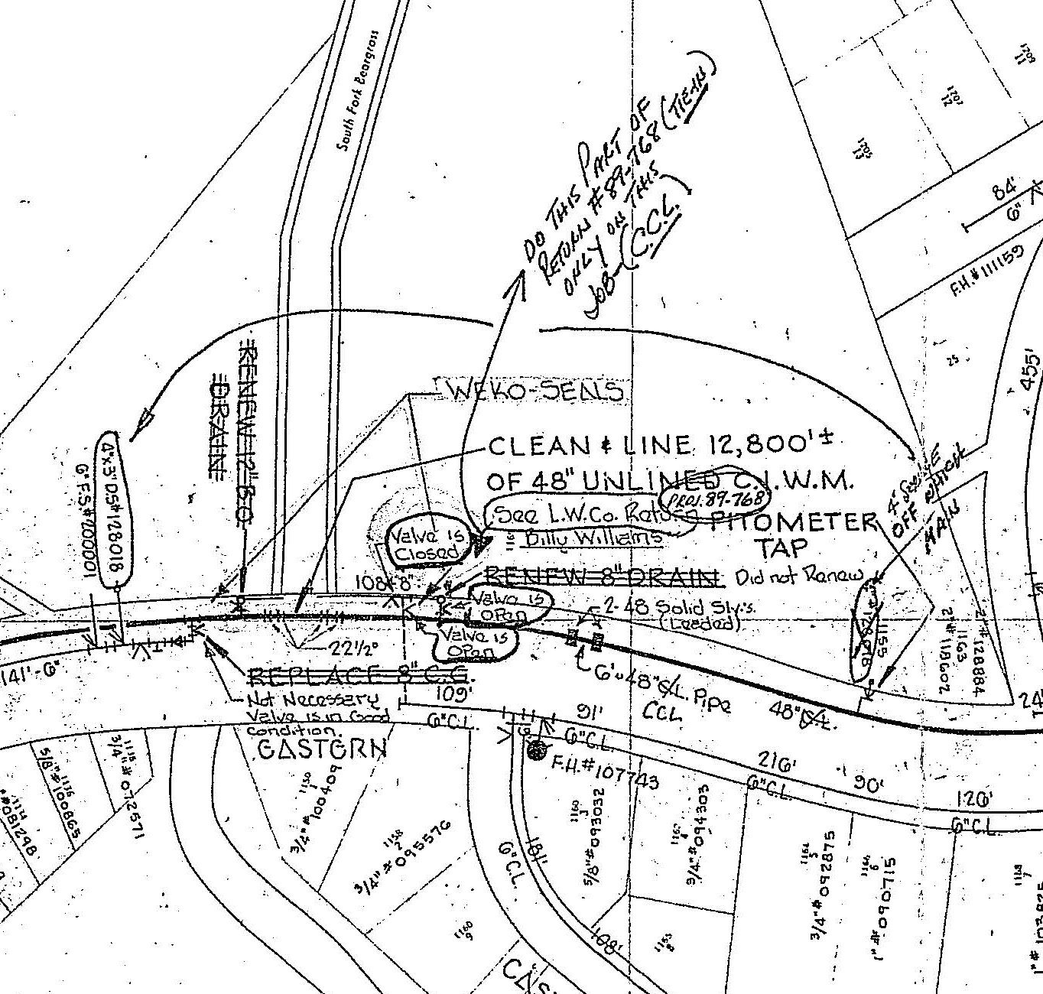
Finding the Booty
Maps are a Pirate’s Best Friend (Besides his Hook)
Utility Contacts – As-Builts
GIS Information
Line & Grade – Potential Conflict Areas to dig (Cuts, Ditches, Proposed Pipes, Critical Utility Systems)
Google Earth / Street View / Open Source Maps
Evidence in the Field
Valves / Meters / Signs / Markers / Manholes / Pedestals / Drop Poles
Trench Warfare
BUD Markings
Exposed Pipes

Slide 13
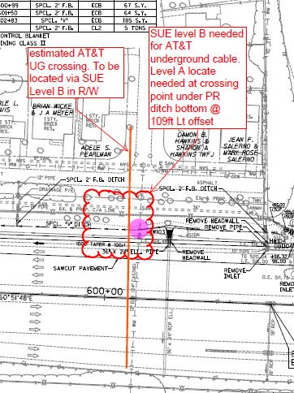
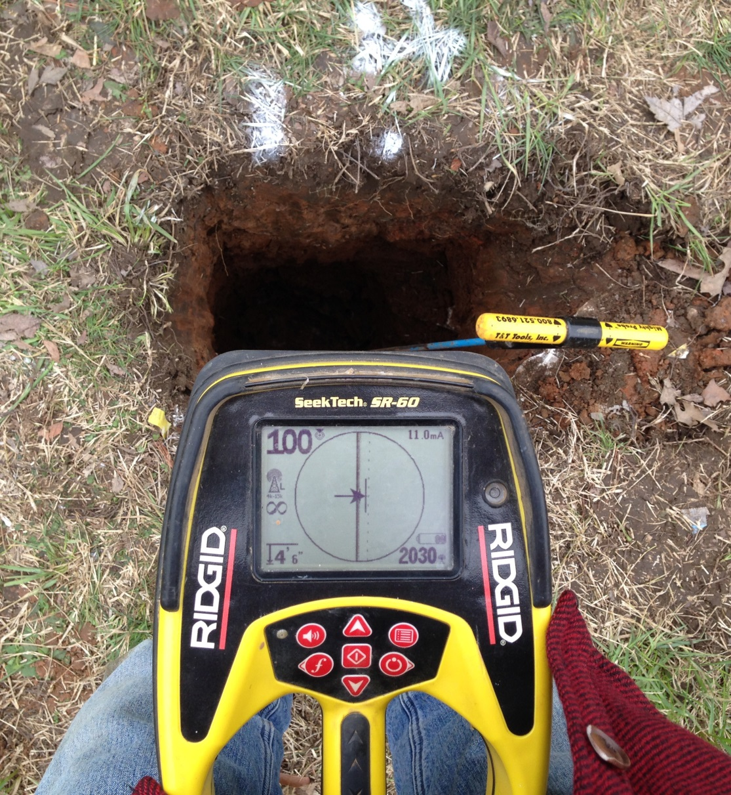
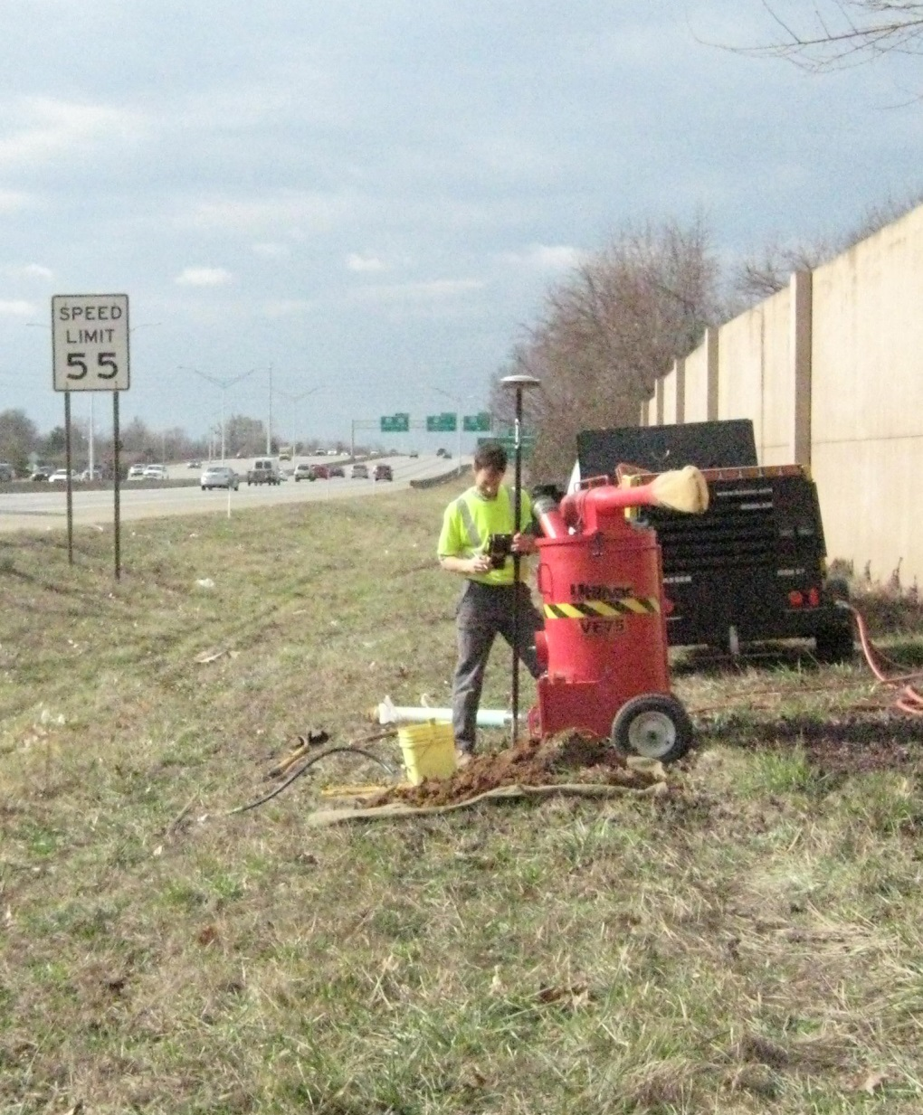

Slide 14
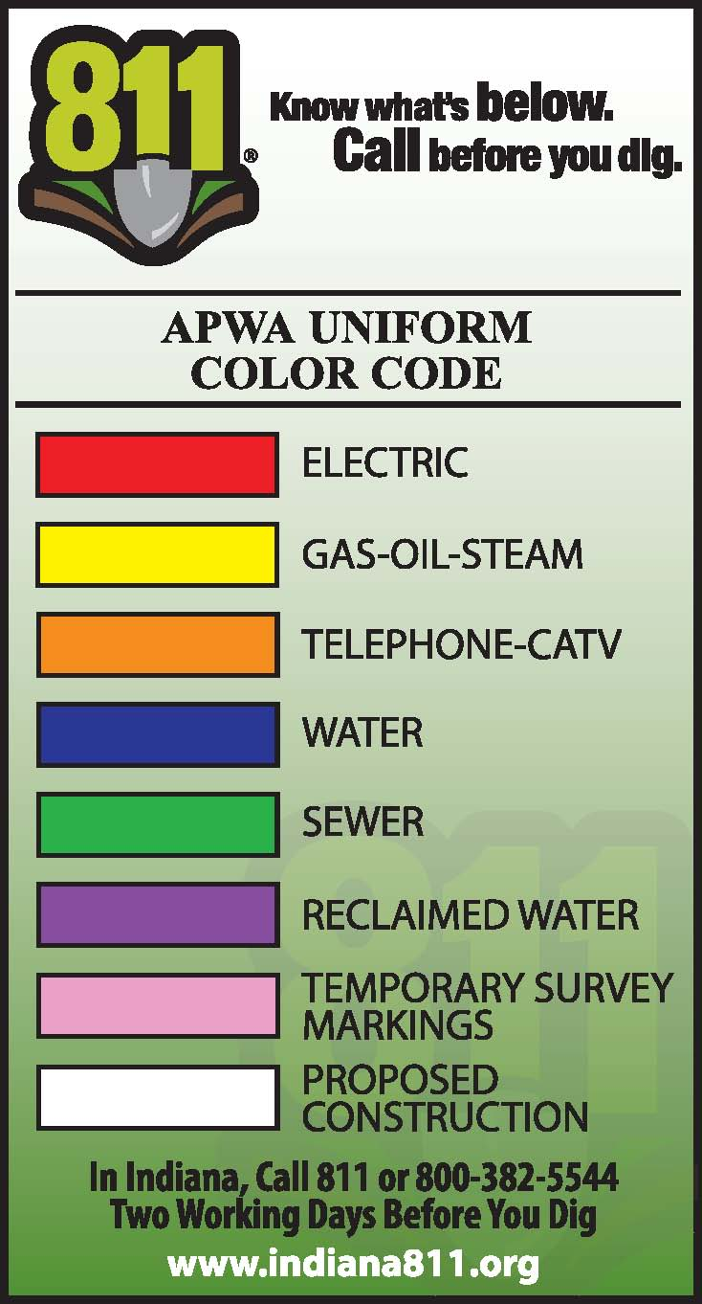
Know What’s Below
BUD 811 Utility Locates
811 Call Center / Web Ticket Entry Dig, Design or Damaged
Utility Locators
Consolidated Locating Services (USIC)
Private Locating Consultants
Electromagnetic Induction Tracing
What about GPR?
When in Doubt – Witch it Out
If I were a pirate…where would I hide my Booty…

Slide 15
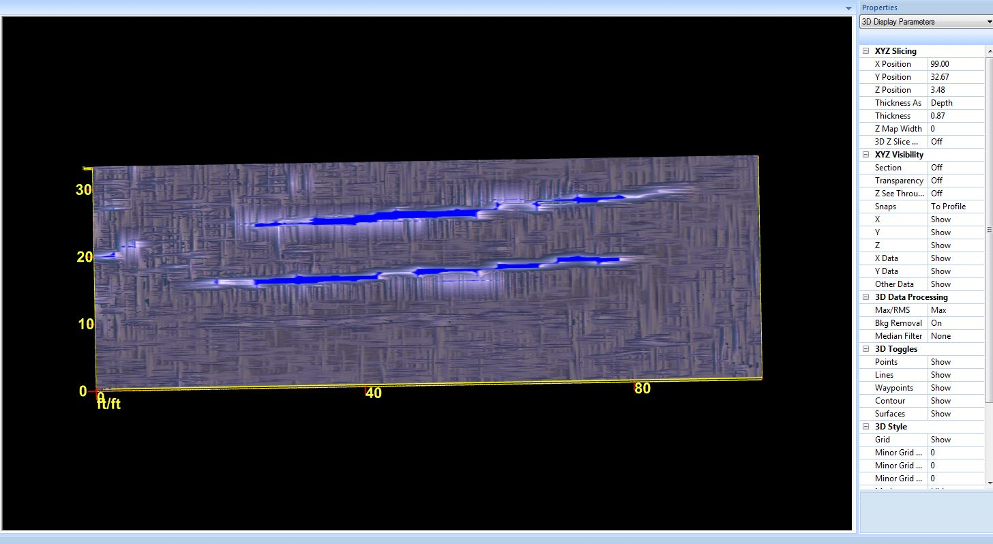
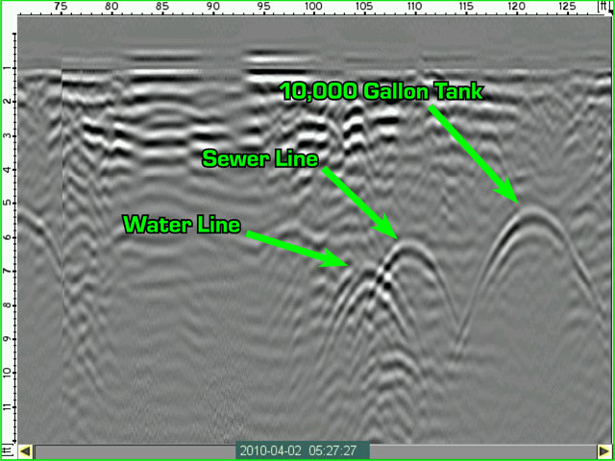
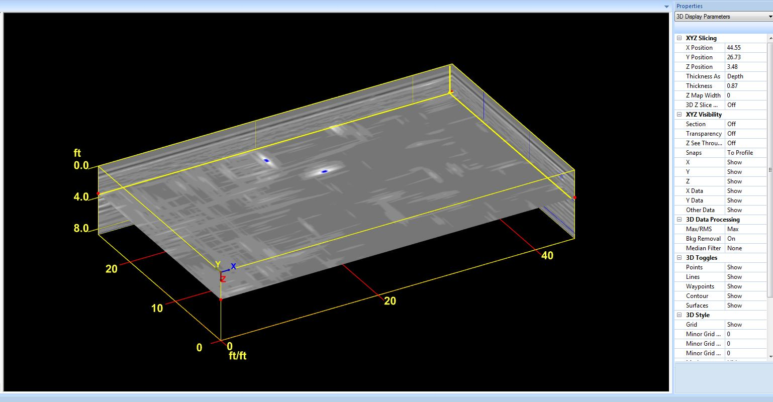
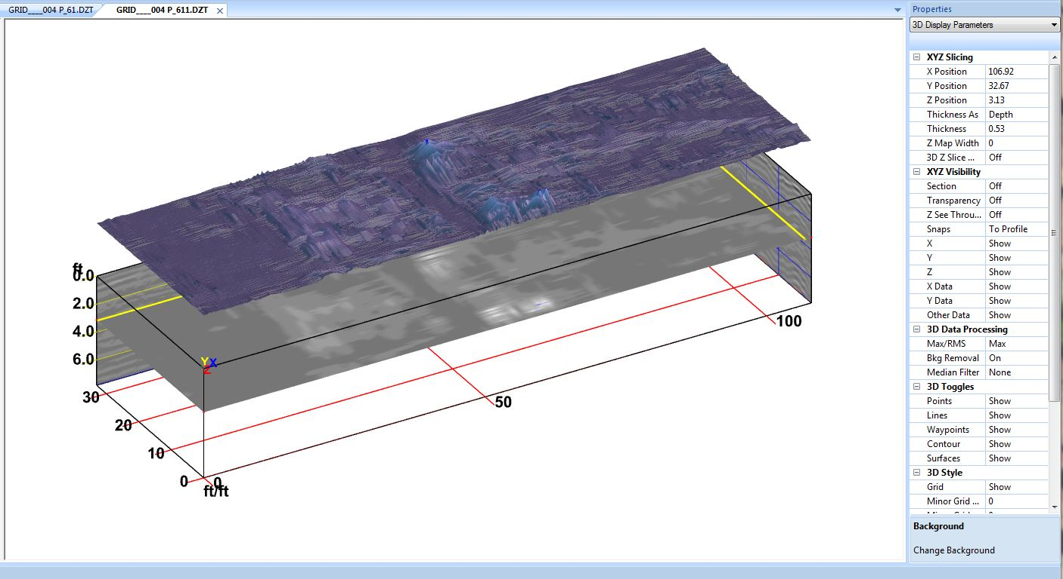
Imaging the Ground

Slide 16
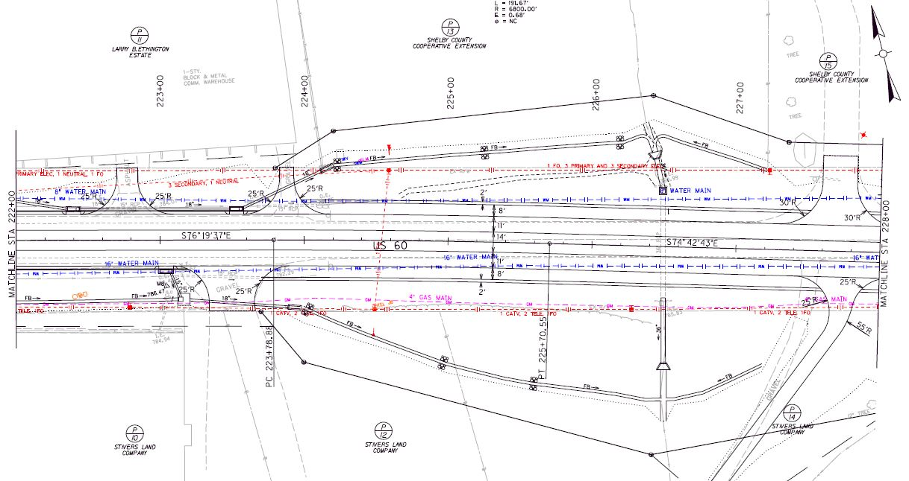
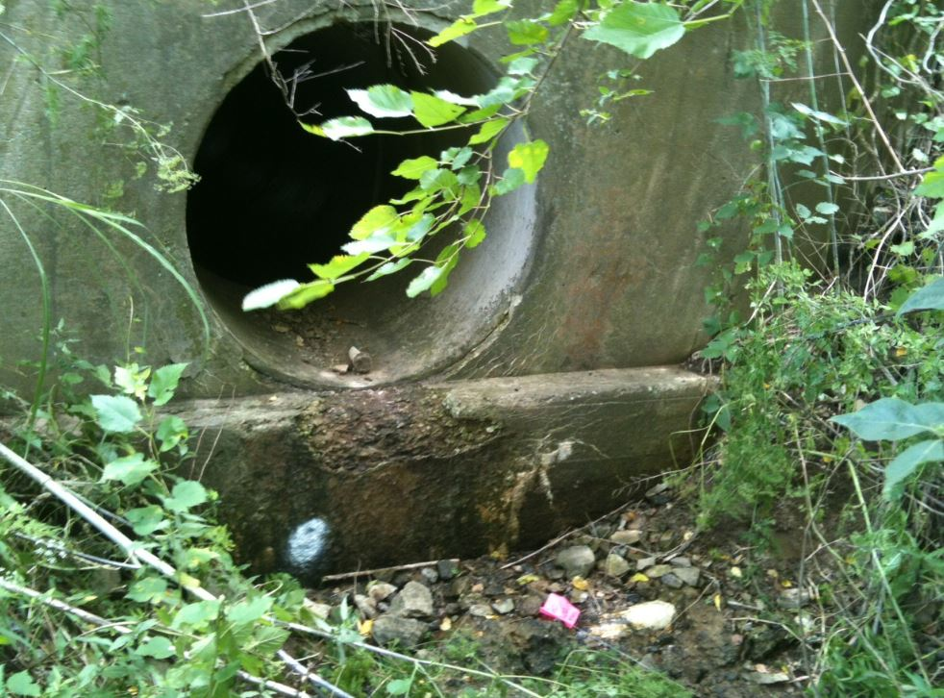
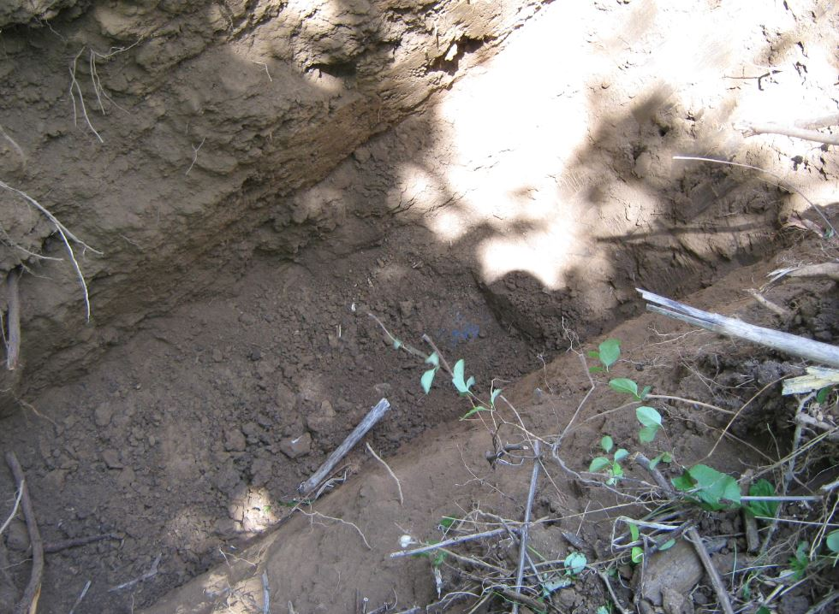

Slide 17
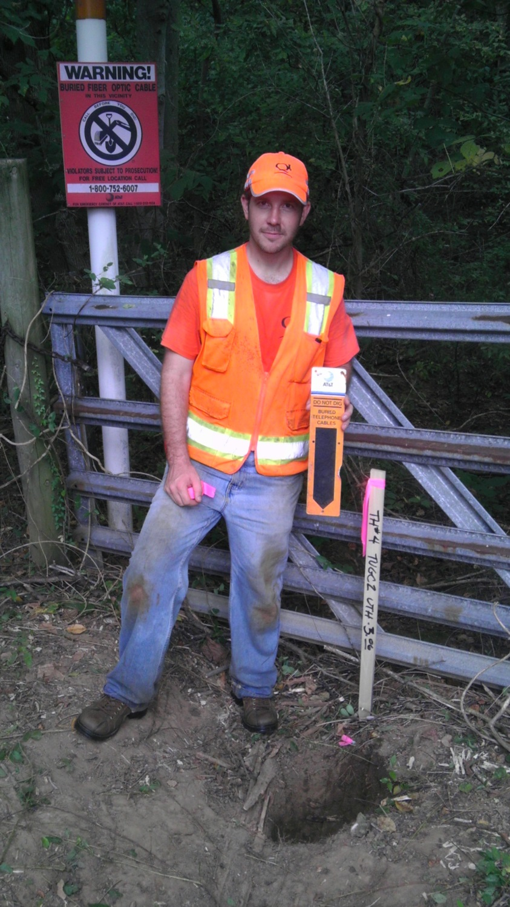
Digging for Gold (Knuckle Deep)
ASCE 38-02 Non-Mechanical Means
Utility Probe
Shovel
Posthole Diggers
Vacuum Excavation
Air Vac Systems
Wet Vac Systems
The Mother of all Gold Diggers

Slide 18
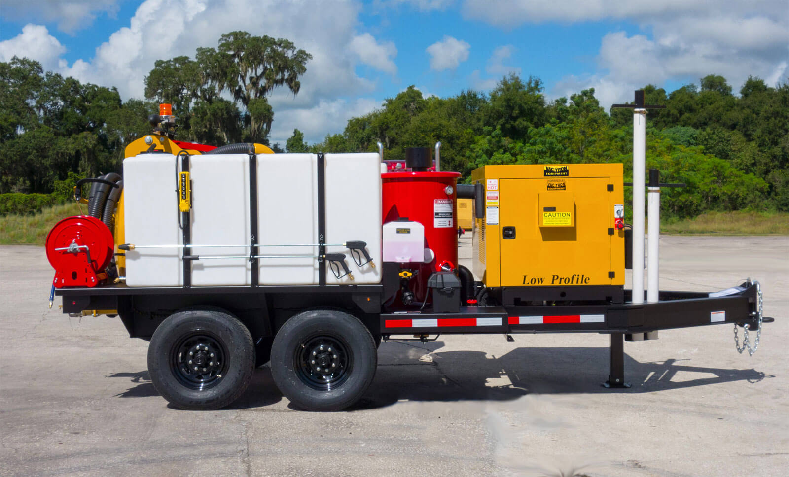
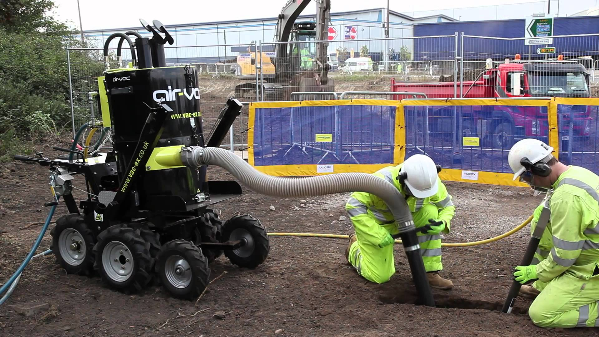
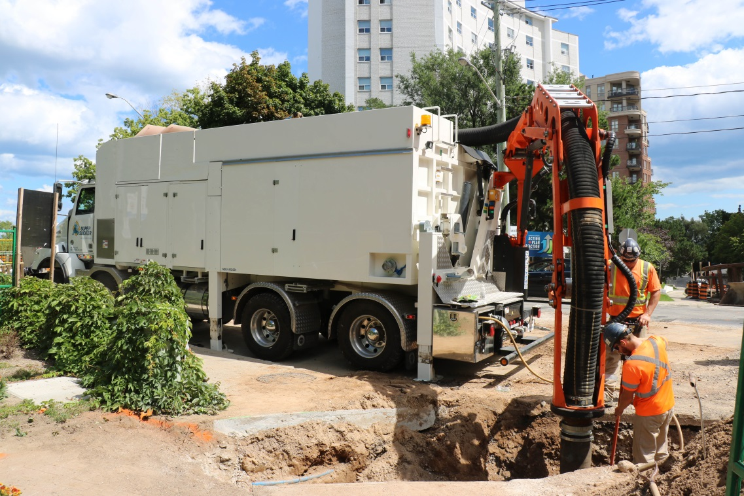
Dig – Rig’s
Wet Vac
Air Vac
Mega Vac

Slide 19
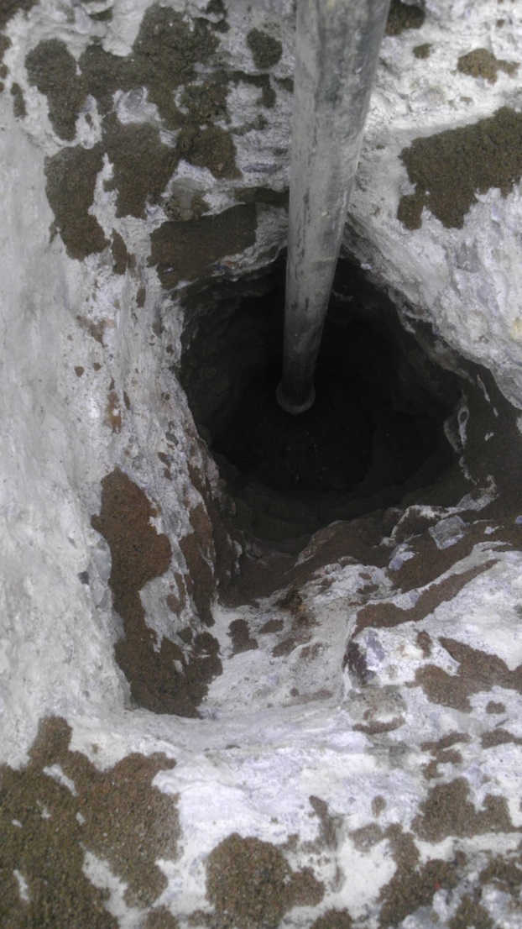
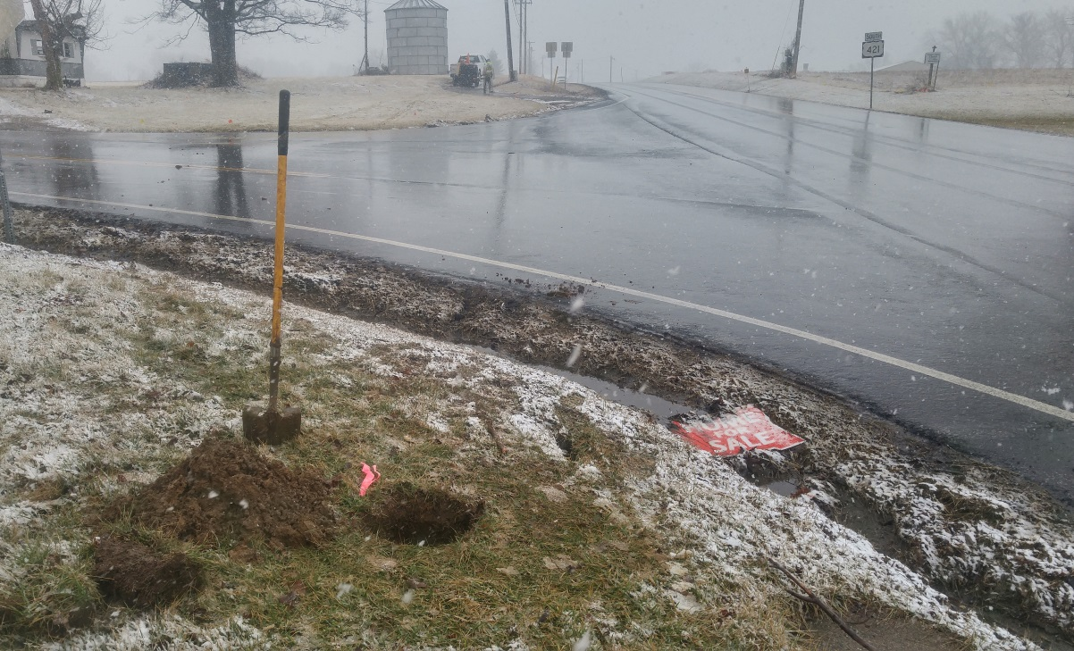
Frustrations that make a Pirate want to…
Rocks for Backfill
No Tracer Wires
Hard Clay Soils
PVC Force Mains
Jefferson County USIC
Frozen Ground / Frozen Booty

